Slide 1
Continuous Innovation:
Building and Sustaining a Culture of Continuous Innovation

Slide 2
CULTURE?

Slide 3
Merriam Webster
“The set of shared
attitudes, values, goals and practices
that characterizes an institution.”

Slide 4
Simon Sinek.
WHAT

Slide 5
Simon Sinek.
HOW
WHAT

Slide 6
Simon Sinek.
WHY
HOW
WHAT

Slide 7
Start With Why.
“People don’t buy what you do,
They buy why you do it."
- Simon Sinek
WHY
HOW
WHAT

Slide 9
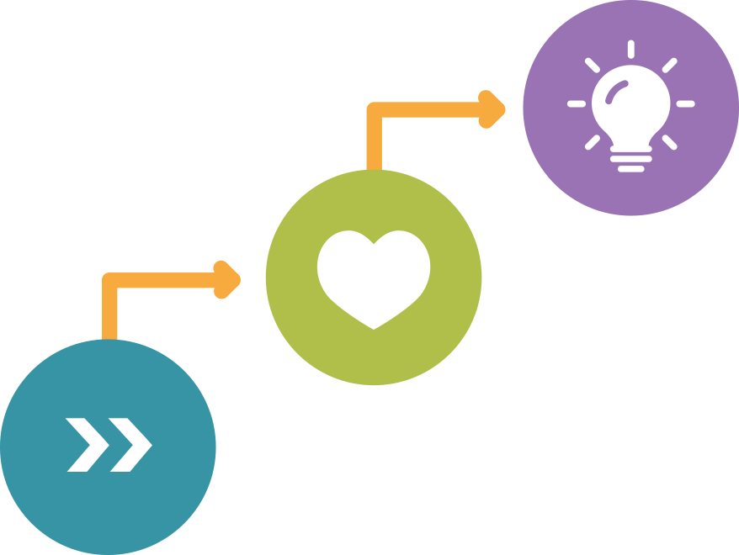
A Shared Goal.
The Mission and the Mantra
INSPIRE
TOUCH
MOVE

Slide 10
Your Customer’s
Journey.
Earning Advocates
ADVOCACY

Slide 11
Your Customer’s
Journey.
Loyalty is a Prerequisite
ADVOCACY
LOYALTY

Slide 12
Your Customer’s
Journey.
Trust is a Prerequisite
ADVOCACY
LOYALTY
TRUST

Slide 13
Continuous Innovation.
A Framework for Adaptive Software Product Development
Mindset and Language
A Learning Model
Product Leadership Discipline
Success Metrics
Voice of the Customer
Engineering Discipline
Tools

Slide 14
CI Mindset.
Continuous Innovation vs. Fixed Mindset

Slide 15
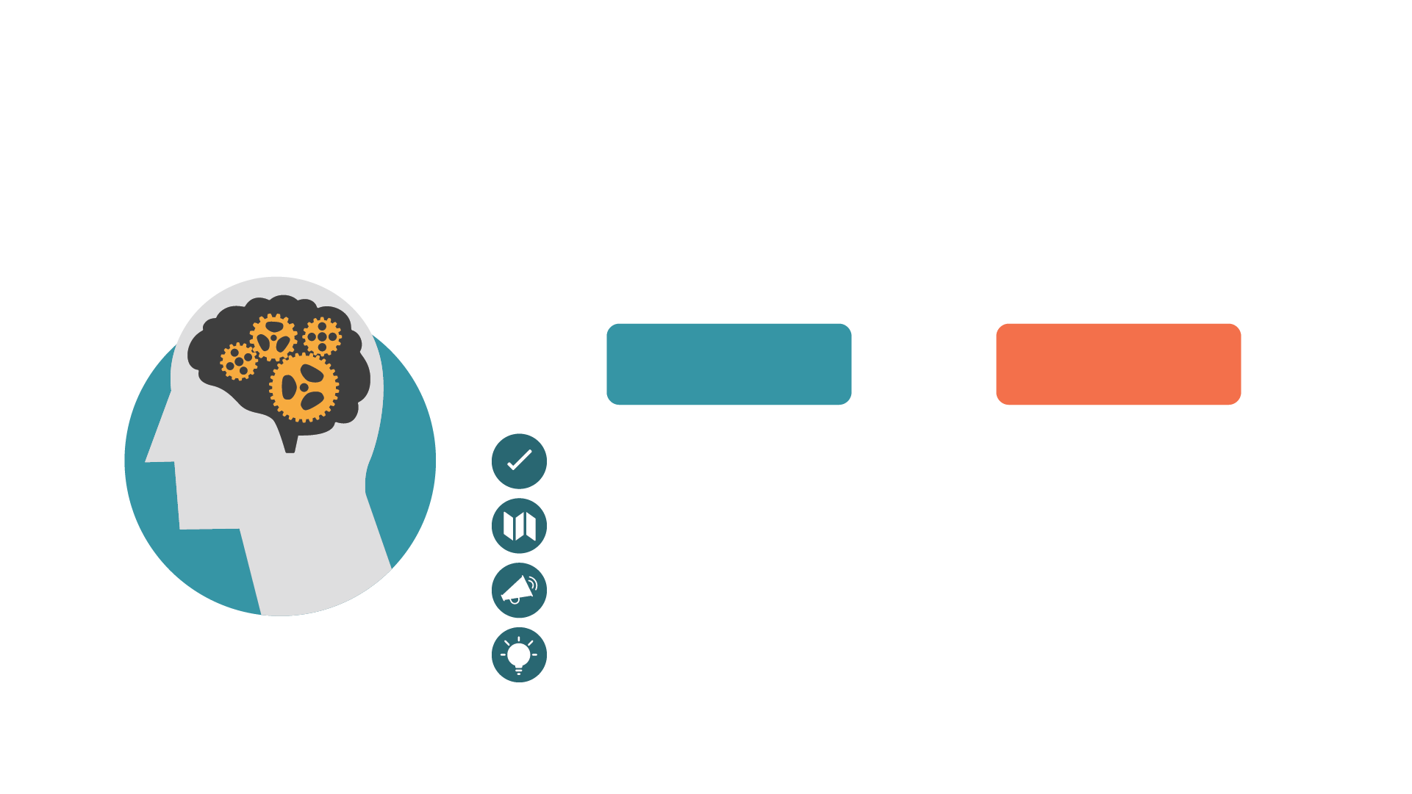
CI Language.
CONTINOUS
INNOVATION
Vs.
FIXED
MINDSET
Requirements
Planning
Voice of The User
Innovation

Slide 16
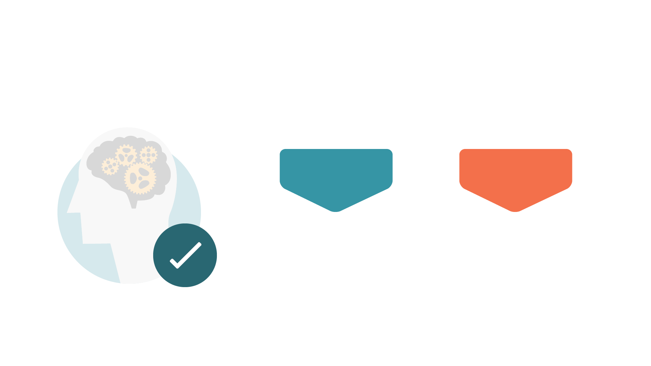
Requirements.
CONTINOUS
INNOVATION
Vs.
FIXED
MINDSET
Maximum feasible requirements
Minimum
necessary to
complete

Slide 17
Planning.
CONTINOUS
INNOVATION
Vs.
FIXED
MINDSET
Healthy,
ongoing backlog
development
Minimal
planning
to complete

Slide 18
Voice of The User.
CONTINOUS
INNOVATION
Vs.
FIXED
MINDSET
Continuous
listening
Ignored for the
sake of
completion

Slide 19
Innovation.
CONTINOUS
INNOVATION
Vs.
FIXED
MINDSET
Abundant
Rare, put aside
for
“future projects”

Slide 20
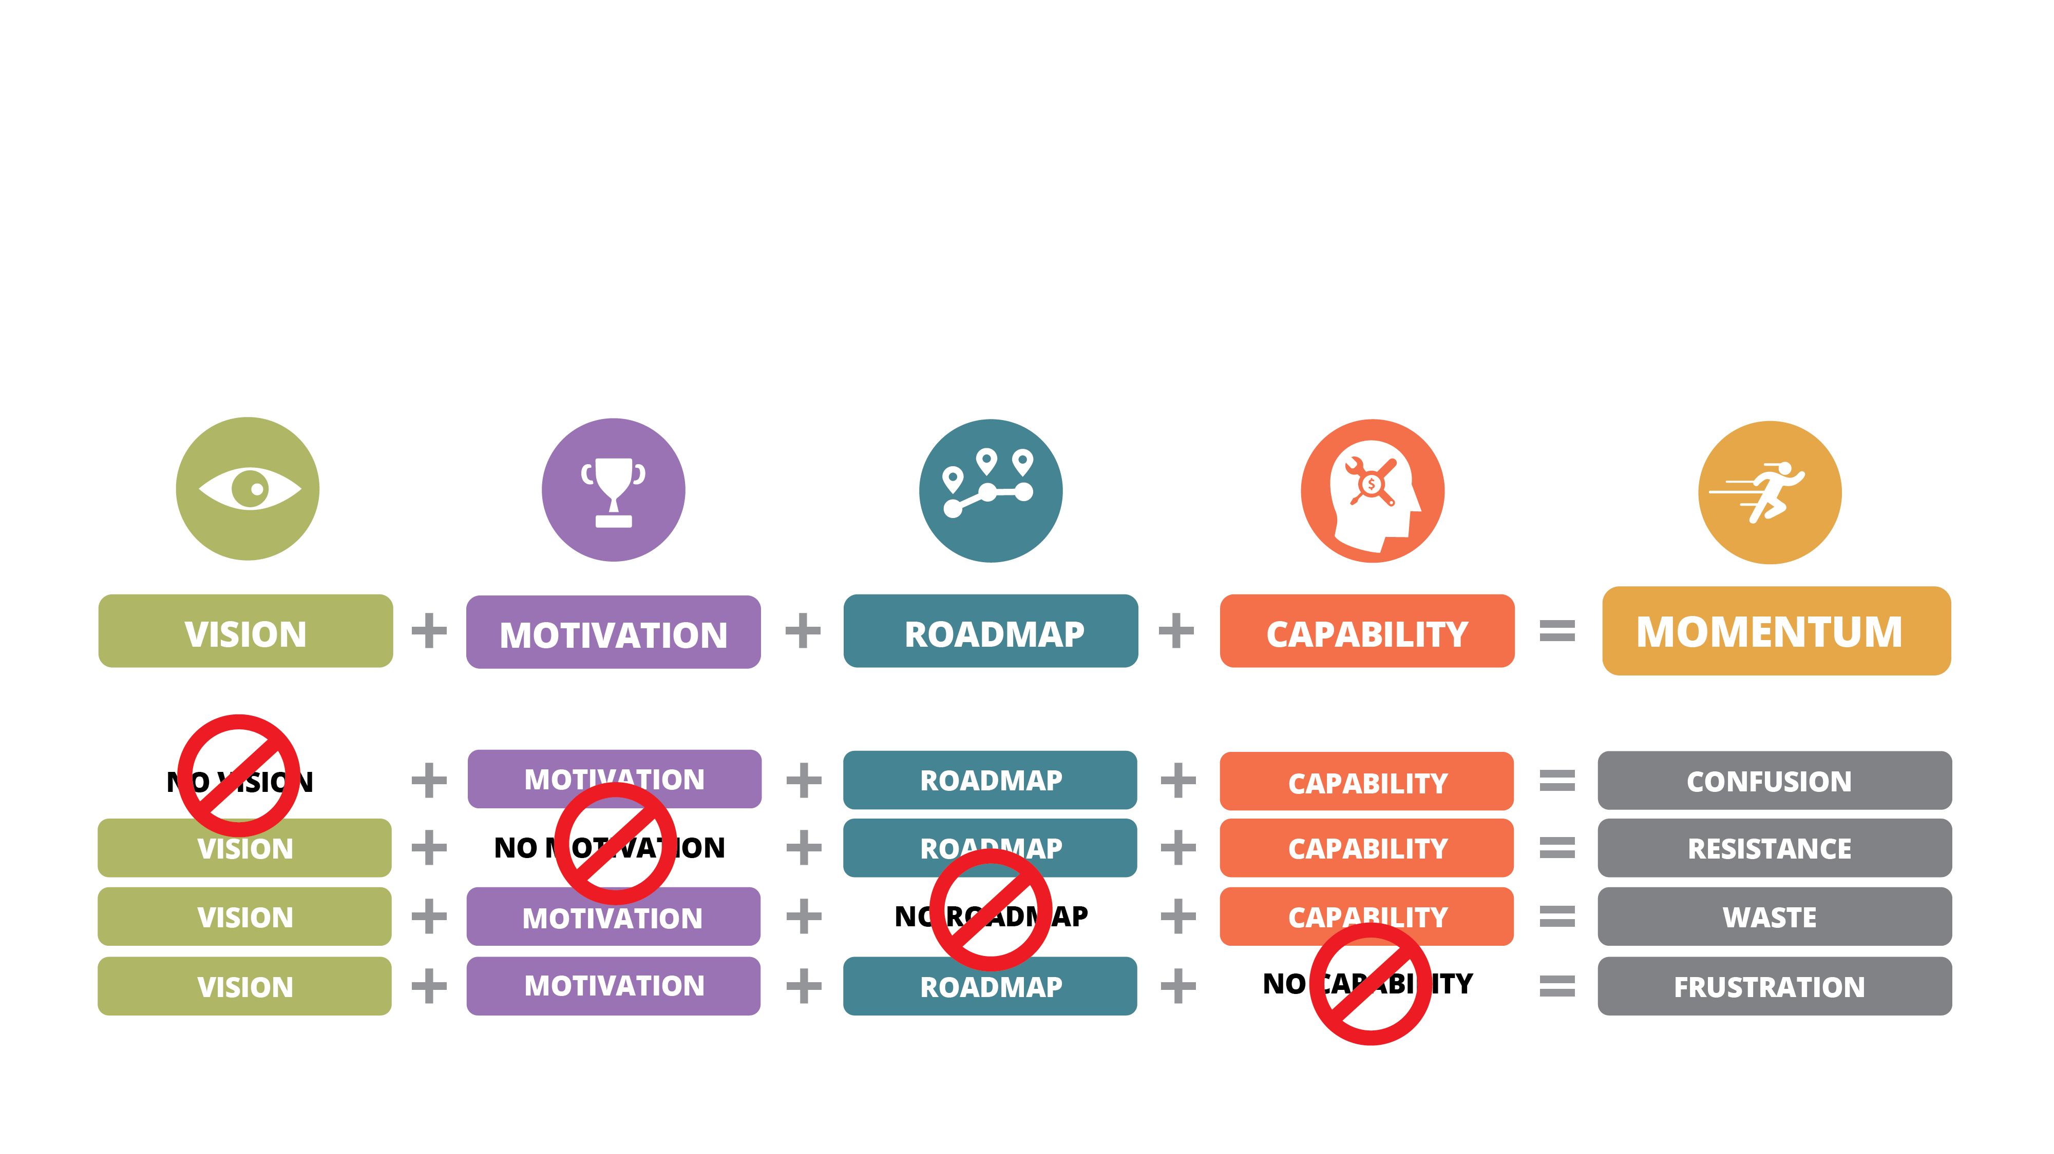
Momentum.
Momentum Requires Discipline

Slide 21
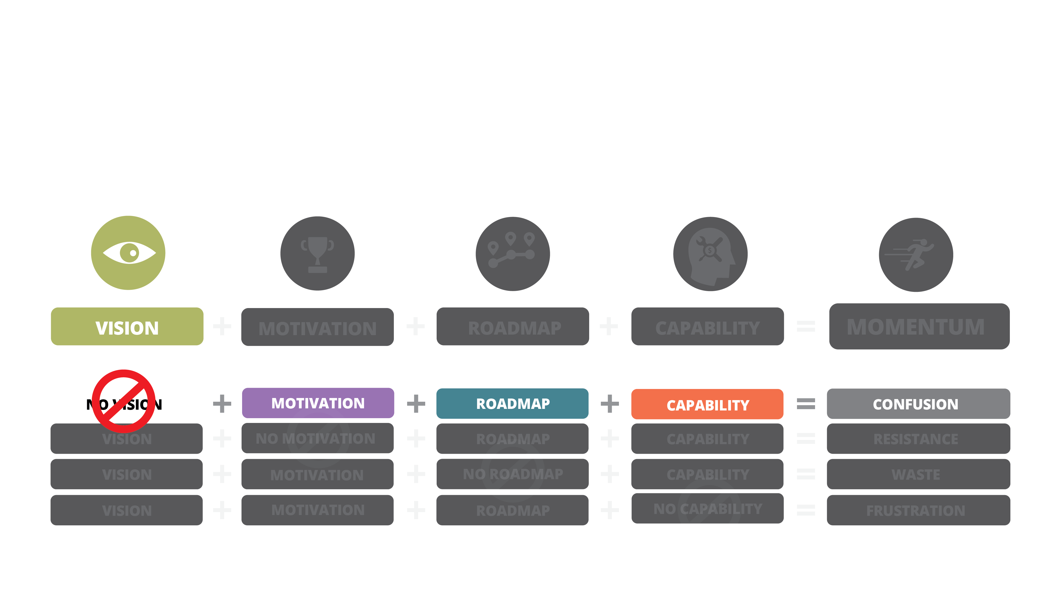
Vision.
Clarity of Customer, Product Mission and What the Customer Values

Slide 22
Motivation.
Aligned, Unified and Energized

Slide 23
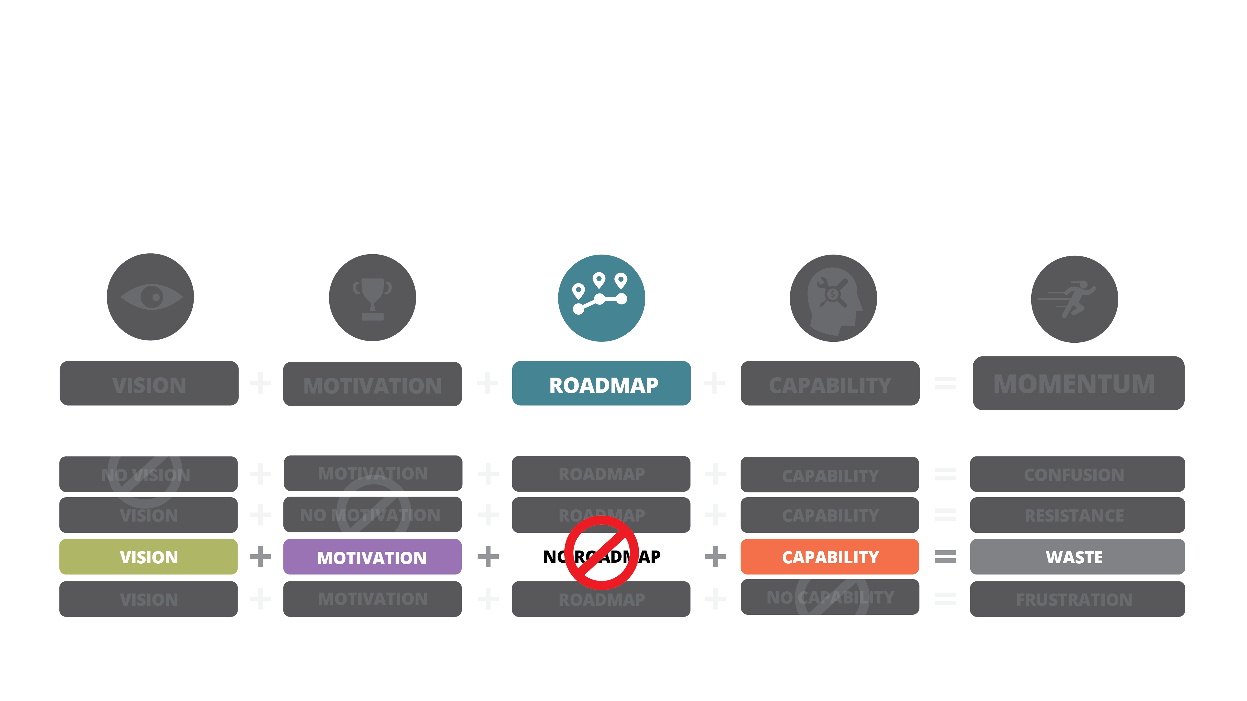
Roadmap.
Once the Roadmap is Agreed Upon, the Product is Unstoppable

Slide 24
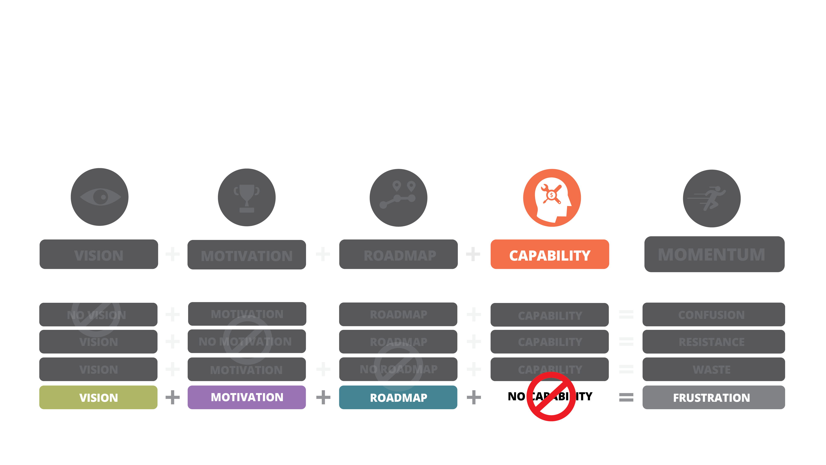
Capability.
Skills, Tools, Knowledge and Capital

Slide 25
Momentum.
Momentum Requires Discipline

Slide 26
What We Know.
Our Collective Wisdom.

Slide 27
What We Know
That We Don’t
Know.
We’re just getting
started.

Slide 28
What We Don’t Know
We Don’t Know.
Our Known Unknown.

Slide 29
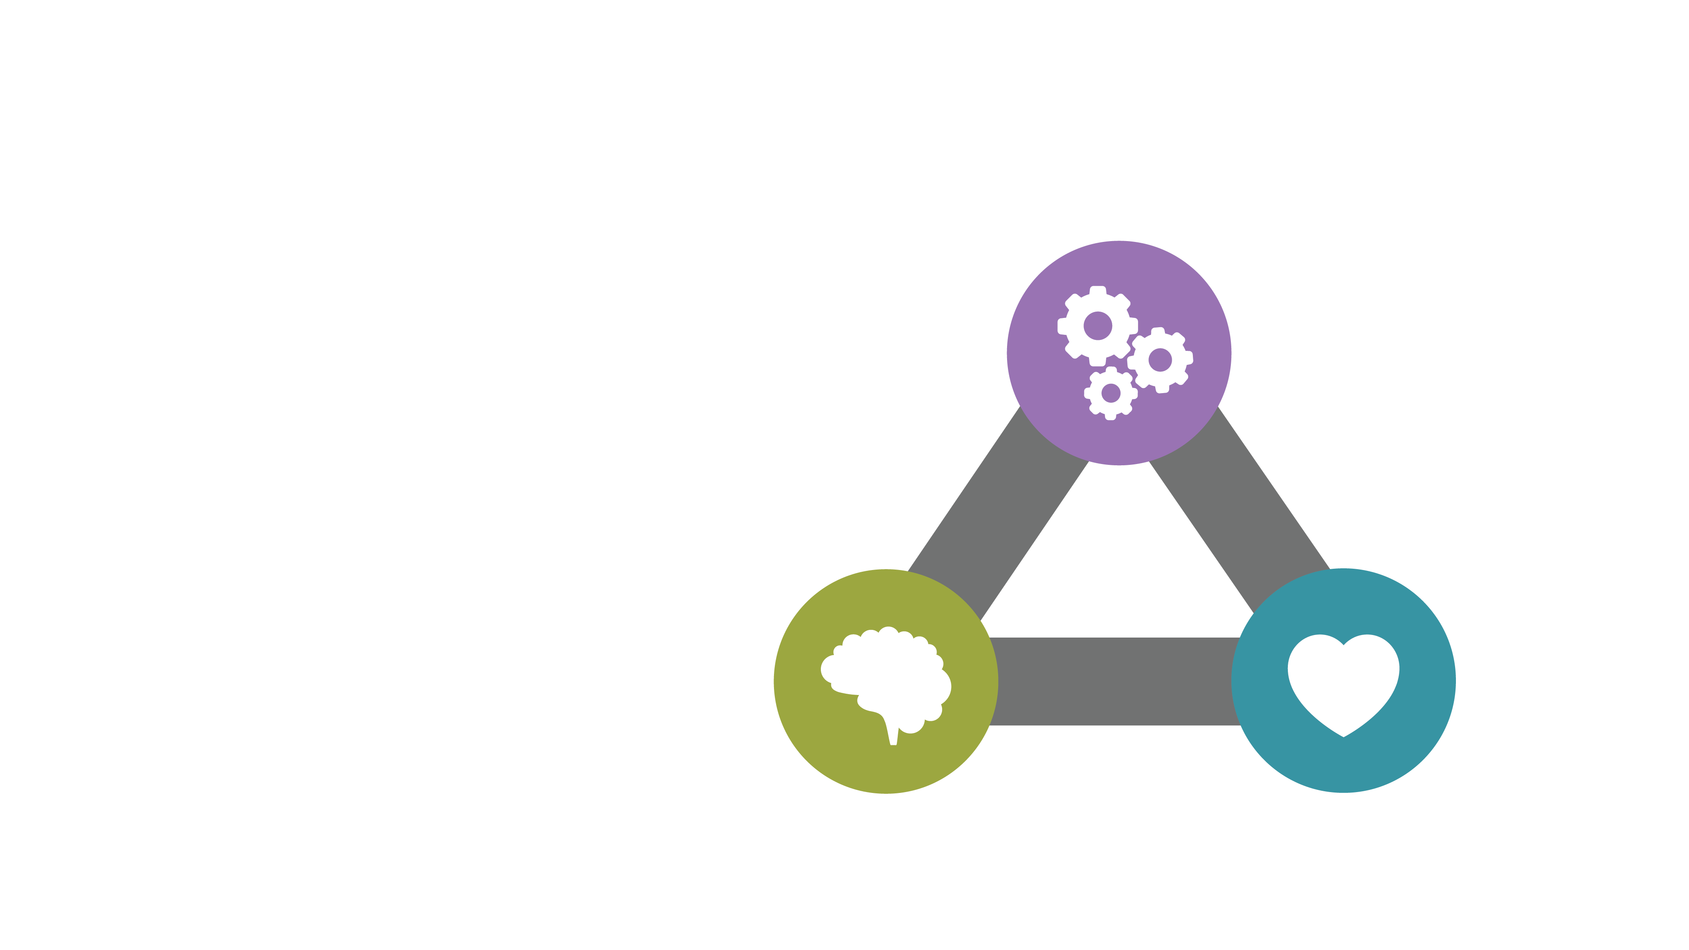
Self
Determination
Theory.
AUTONOMY
The Science of Intrinsic
Motivation.
21,406
COMPETENCE
RELATEDNESS

Slide 30
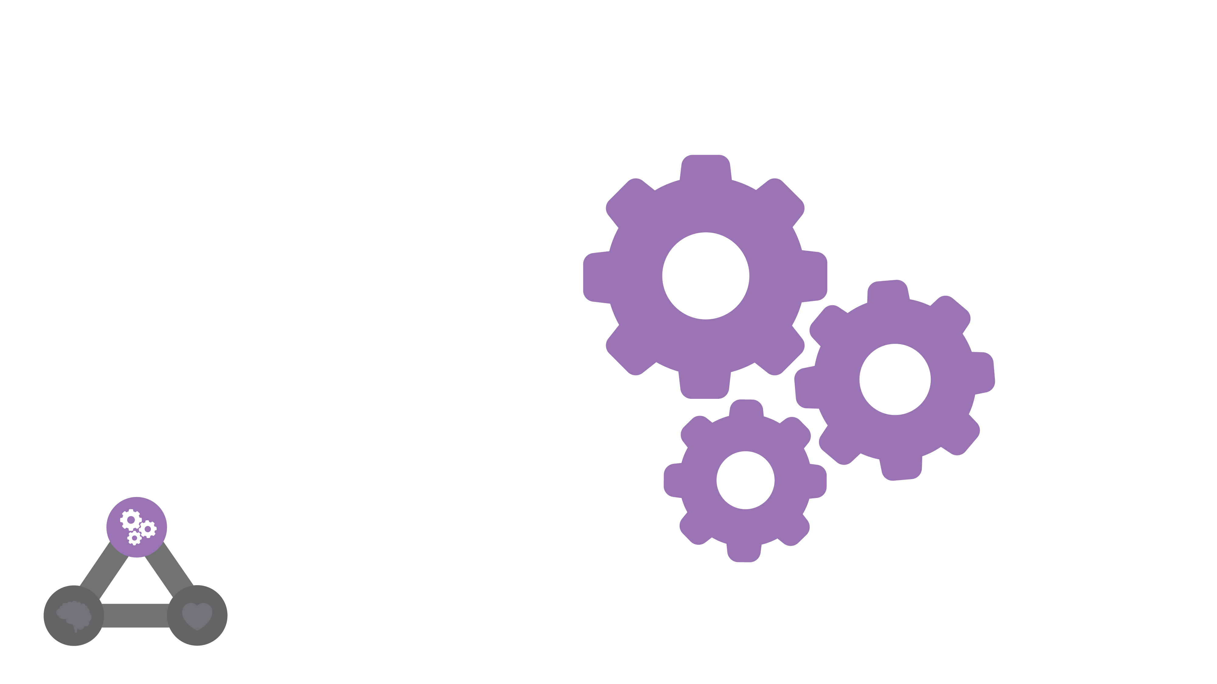
Autonomy.
The Power of Free Will

Slide 31
Relatedness.
Emotional Intelligence in Action
Connection to Purpose

Slide 32
Competence.
Knowing vs. Thinking

Slide 33
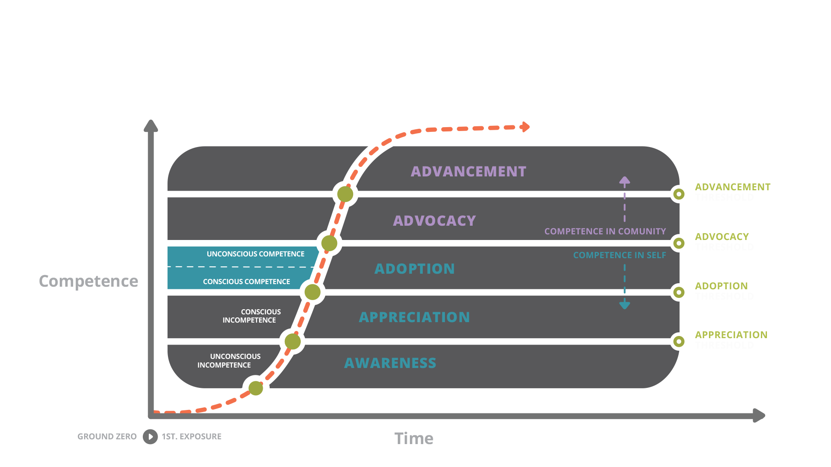
The Competence Continuum.

Slide 34
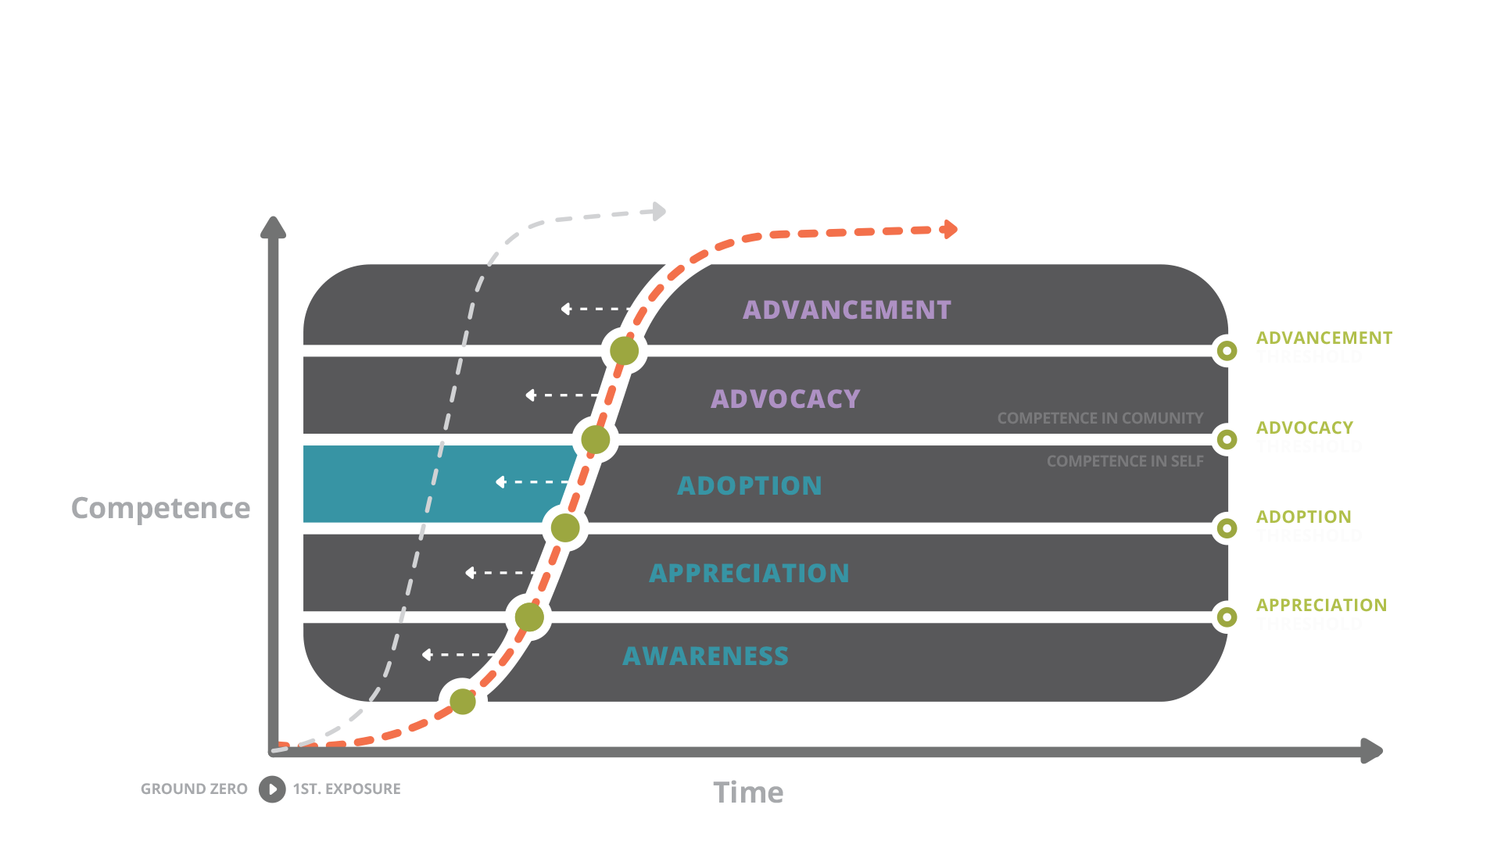
The Competence Continuum.

Slide 35
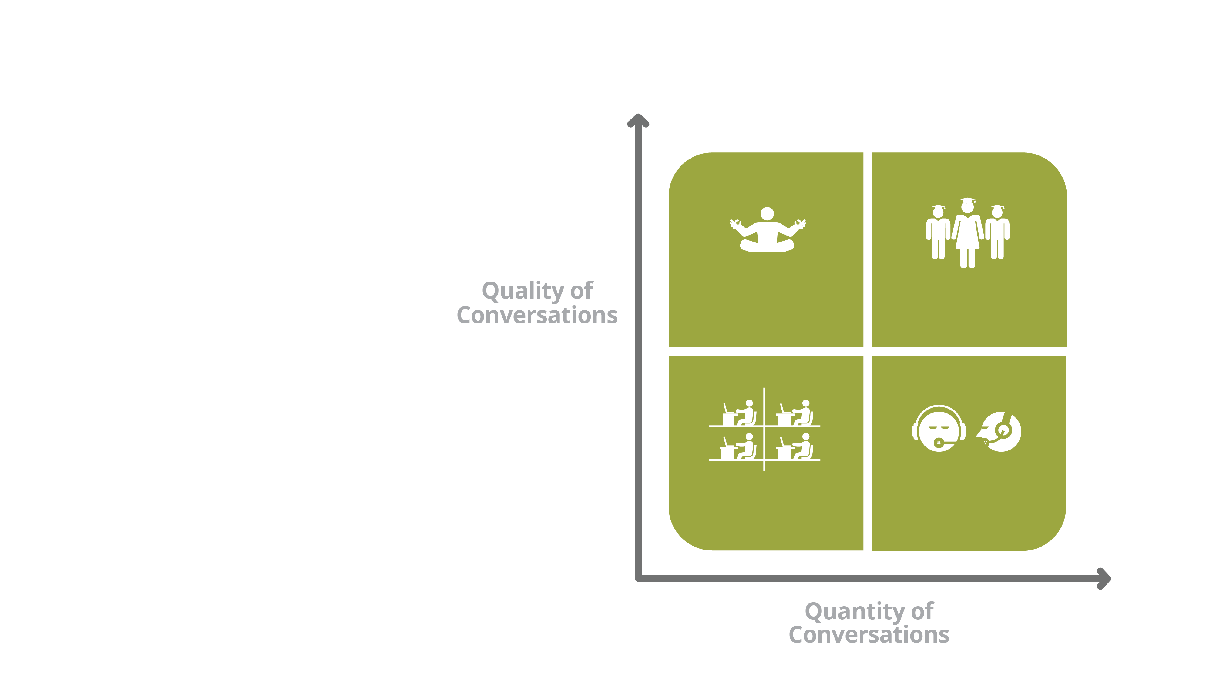
Conversations.
Competence in Community
Guru
Culture
Competence
In Community
Status
Quo
Chaos &
Gossip

Slide 36
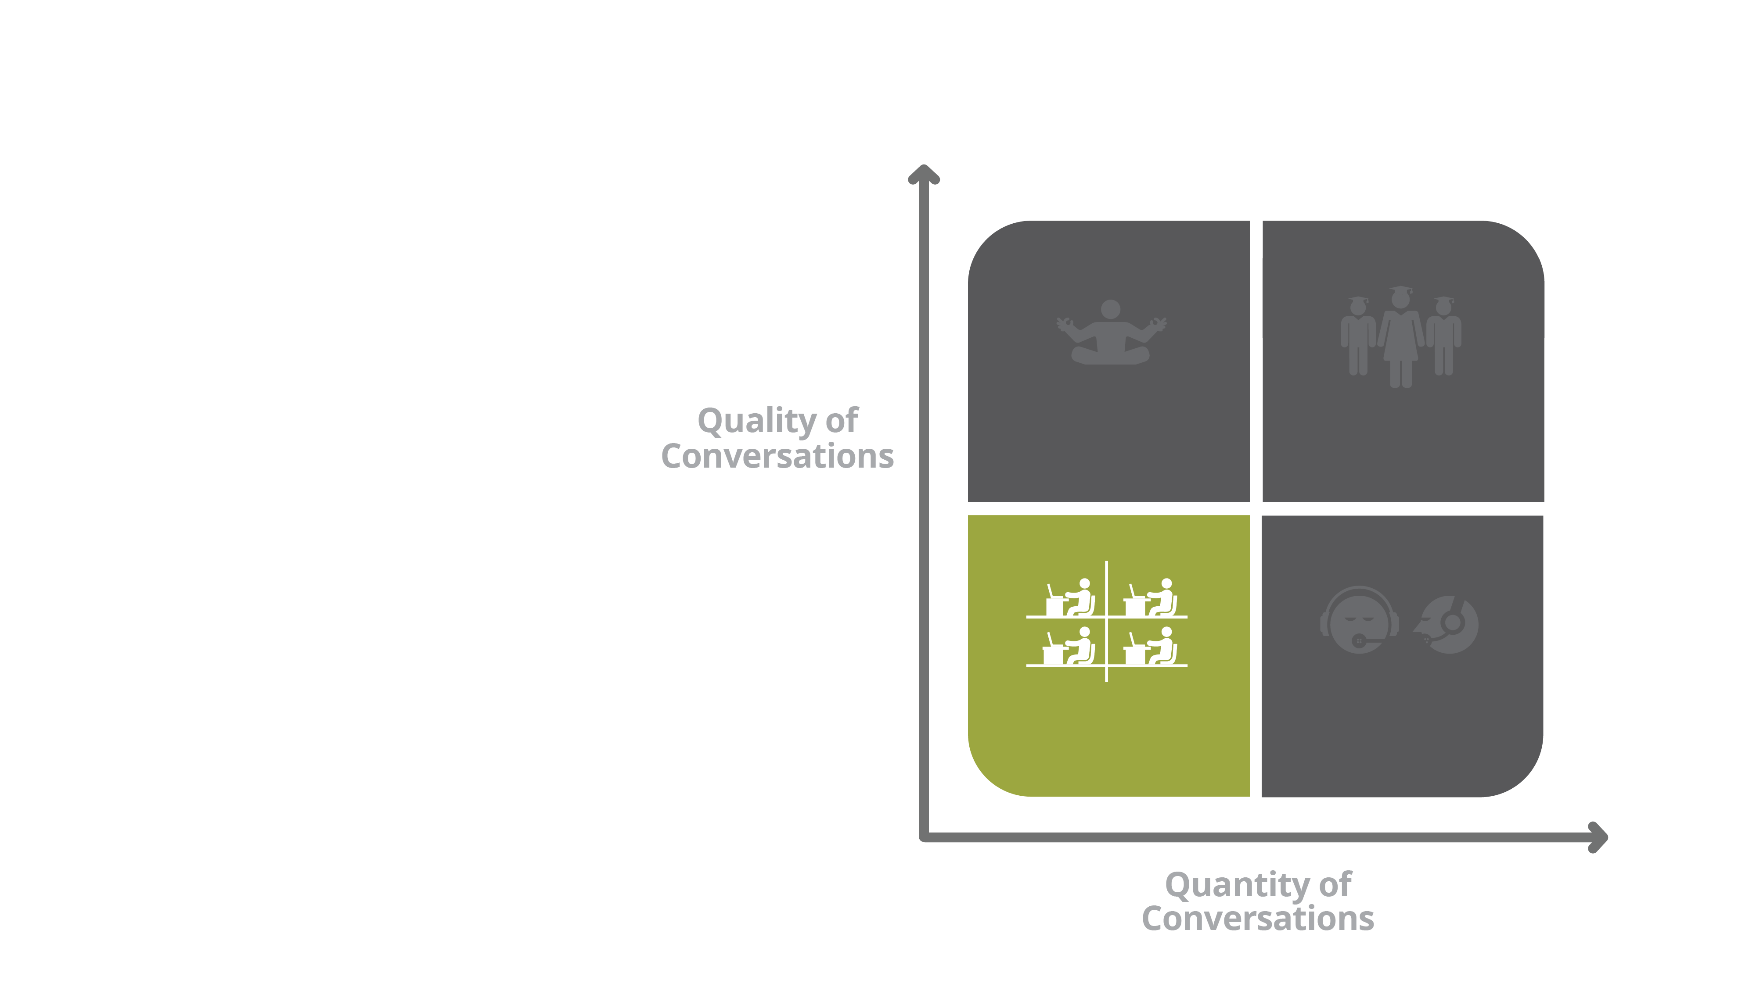
Low Quality &
Low Quantity
Status Quo: No Change in Competence or Culture
Guru
Culture
Competence
In Community
Status
Quo
Chaos &
Gossip

Slide 37
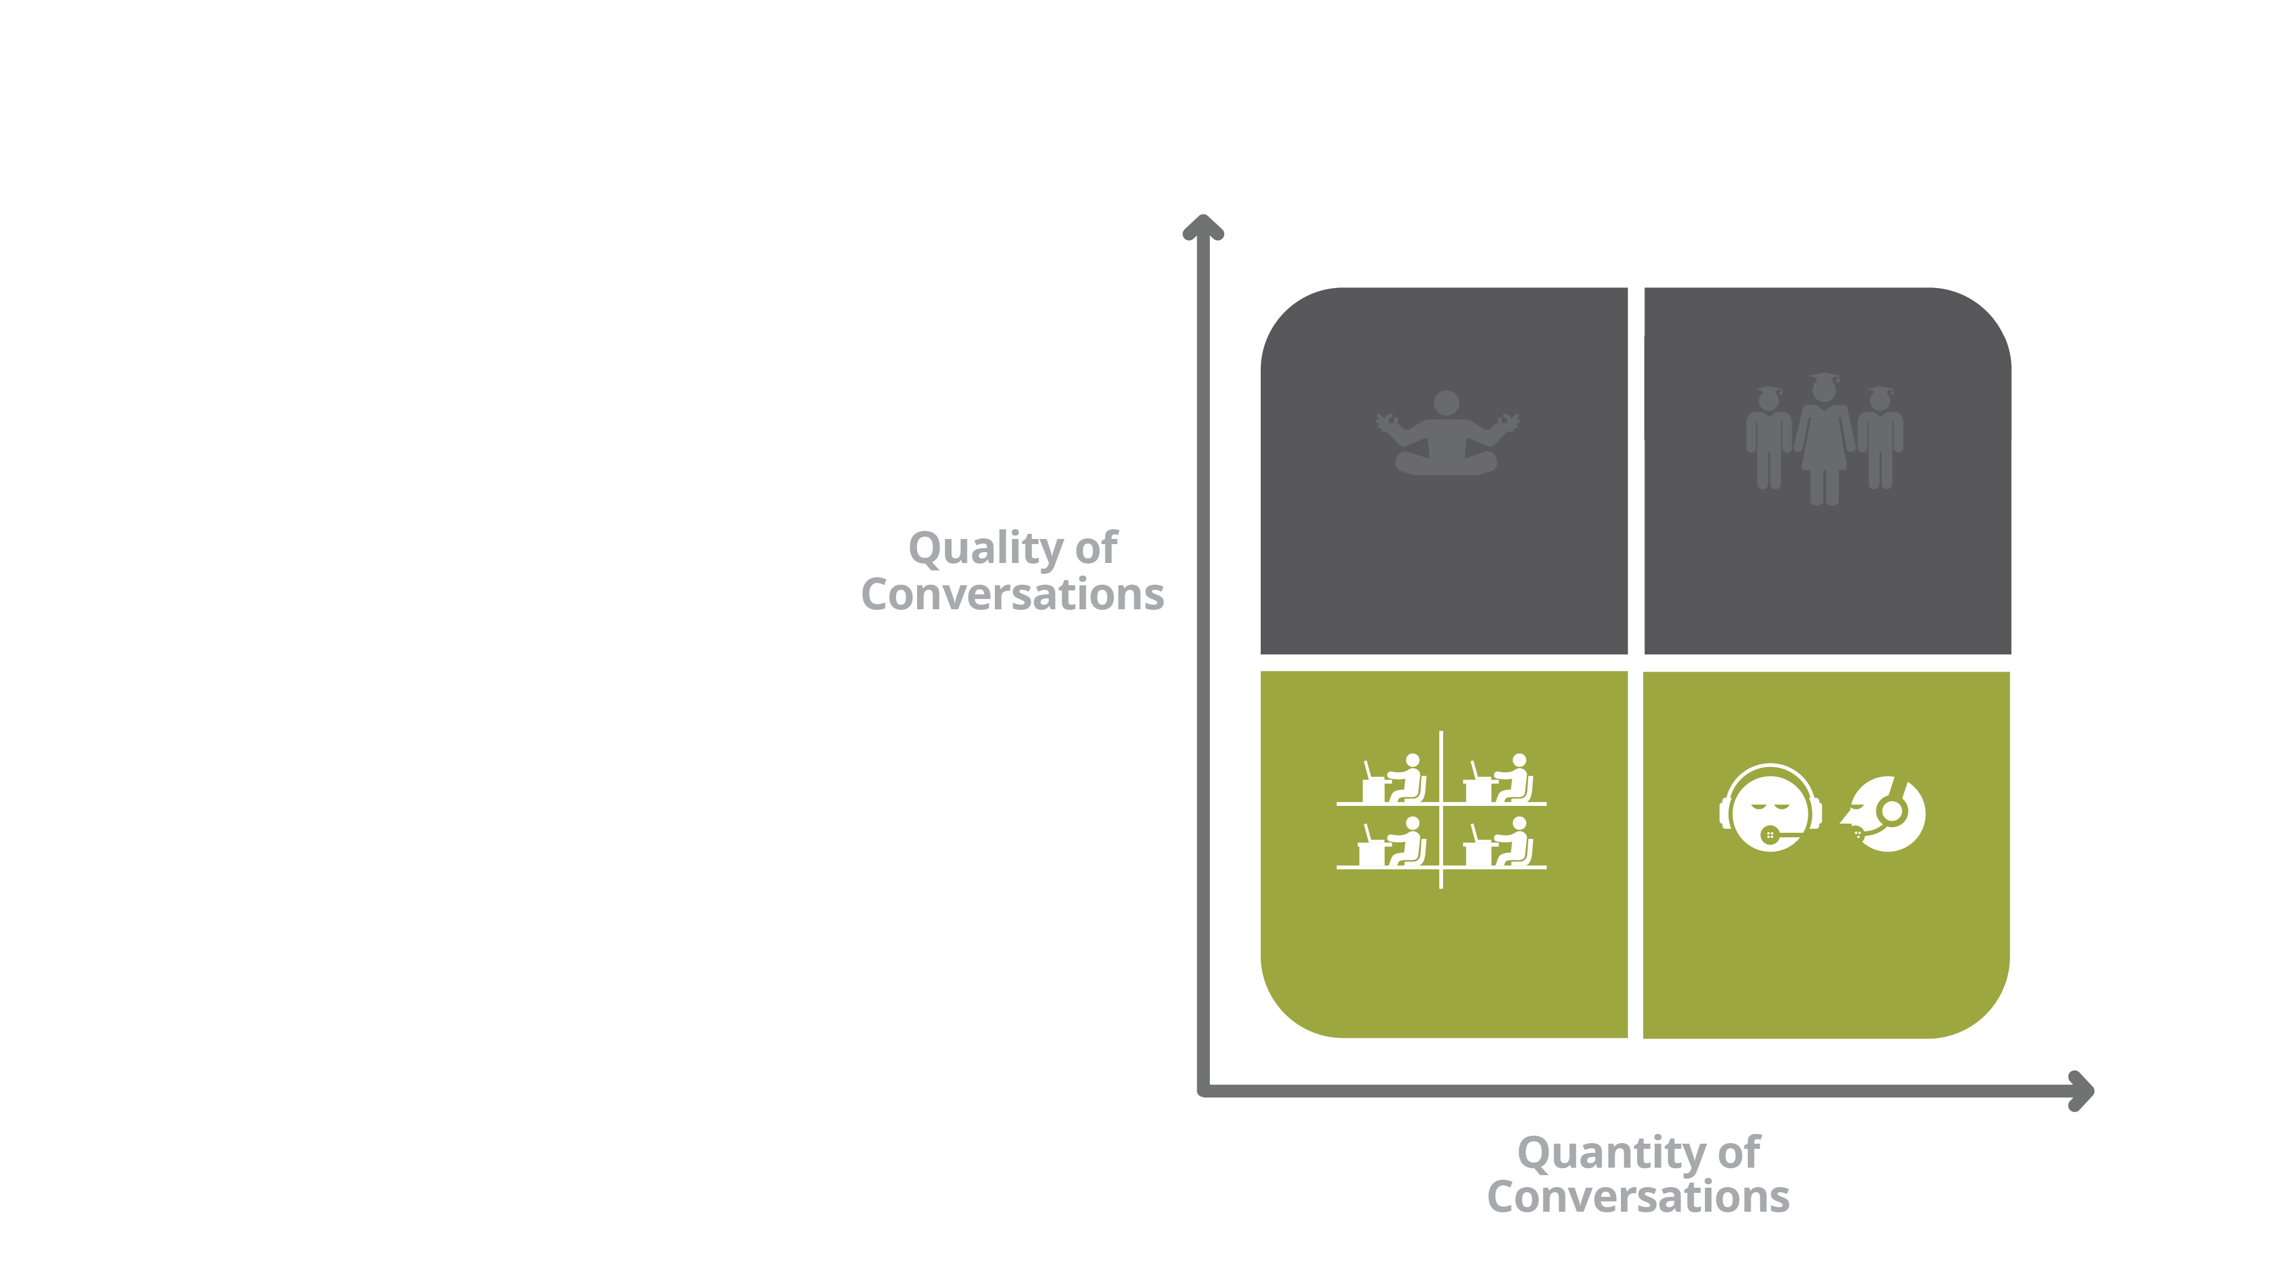
Low Quality &
High Quantity
Chaos and Gossip
Culture Degrading
Guru
Culture
Competence
In Community
Status
Quo
Chaos &
Gossip

Slide 38
High Quality &
Low Quantity
Knowledge Hoarding
Guru Culture
Culture Degrading
Guru
Culture
Competence
In Community
Status
Quo
Chaos &
Gossip

Slide 39
High Quality &
High Quantity
Competence Maximizing
Growth Enabling
Competence in Community
Guru
Culture
Competence
In Community
Status
Quo
Chaos &
Gossip

Slide 40
Leadership Culture.
Traits of Great Product Leaders
OBSERVATION
EMPATHY
PASSION
HYPER-FOCUS

Slide 41
The Power of Observation.
“The first secret of design
is to notice.”
- Tony Fadell, Apple

Slide 42
Listen.
A Model for
”Voice of the Customer”

Slide 43
Empathy.
For Customer Pain and Delight
- Find Sources of Frustration
- Focus On Experience
- Get “In Their Heads”
- Users First

Slide 44
Personas.
Know your users: Continuously “Groom” Your Personas like you would your requirements

Slide 45
A Passion.
For The Details.
- ”Details Matter” Mindset
- Design Thinking
- Demanding of High Quality

Slide 46
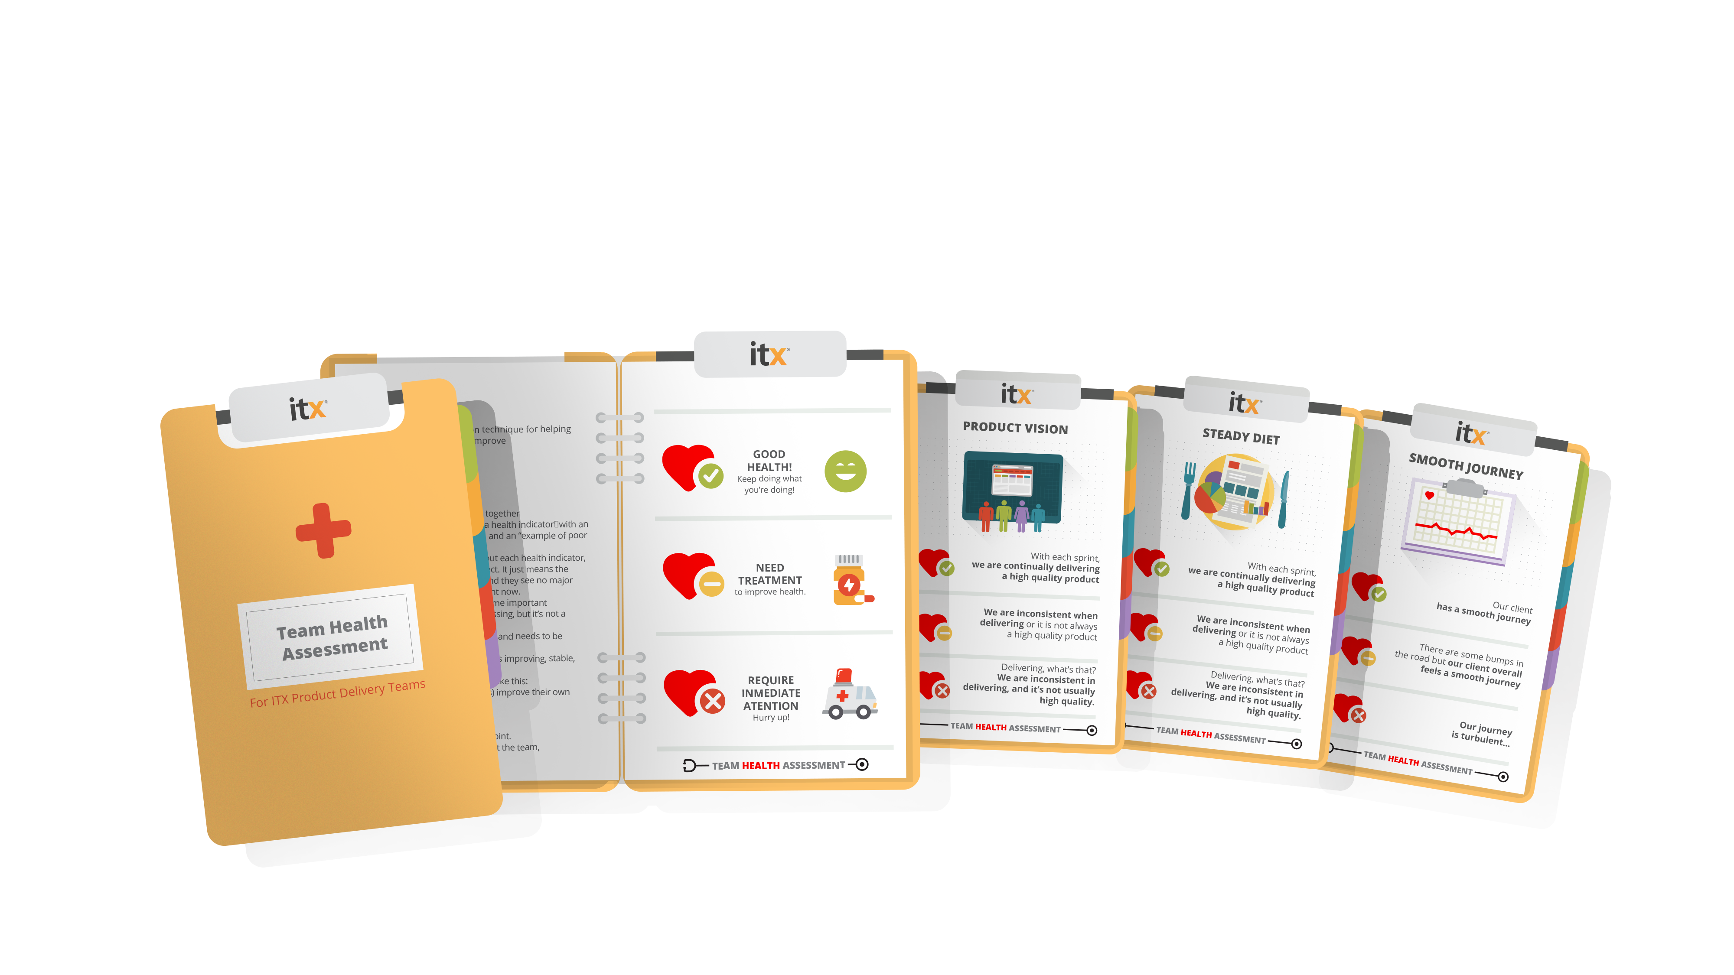
Team Health Assessment.
Measuring Pulse

Slide 47
A Hyper-Focus.
On Continuous Innovation
- Measurement and Data
- Voice of the Customer
- Real Time Strategy
- Always Learning
- Continuous Innovation Mindset

Slide 48
Micro-strategy.
Continuous Innovation

Slide 49
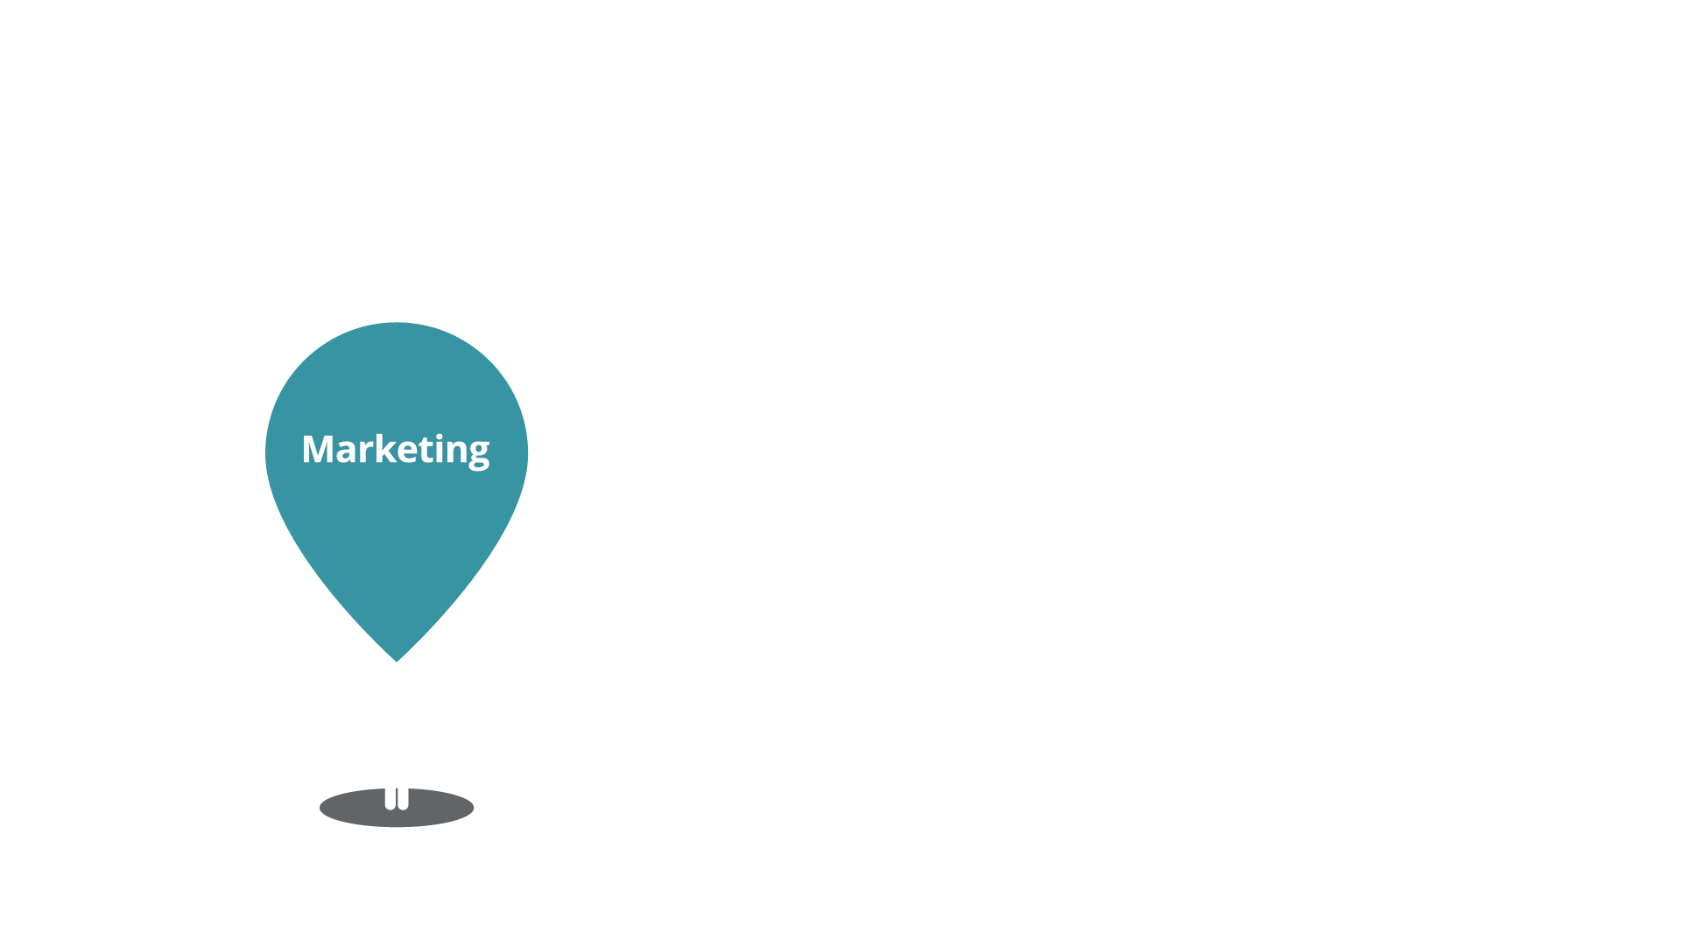
Your Customer’s Journey.

Slide 50
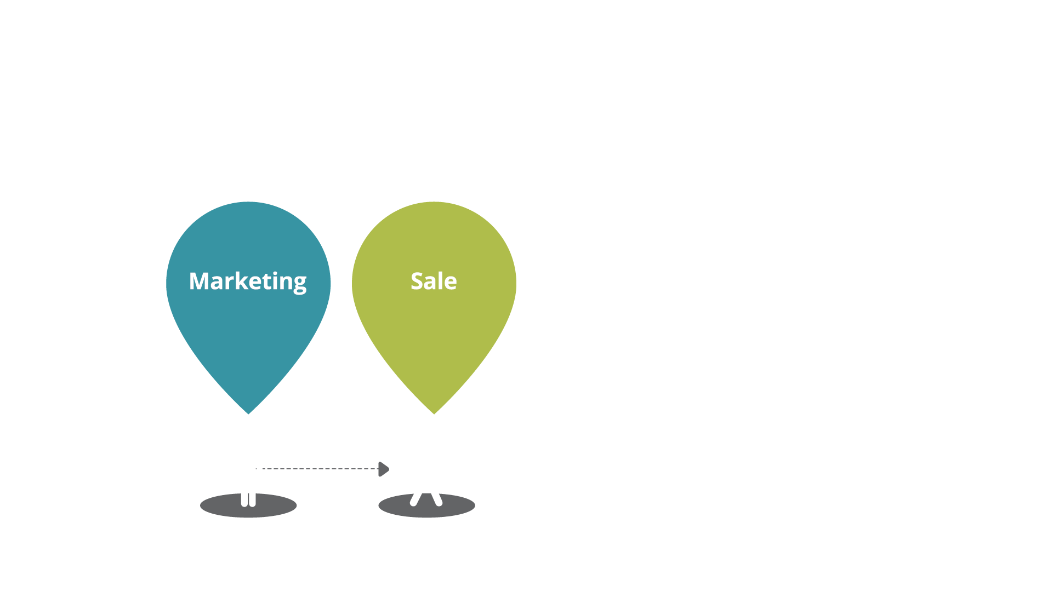
Your Customer’s Journey.

Slide 51
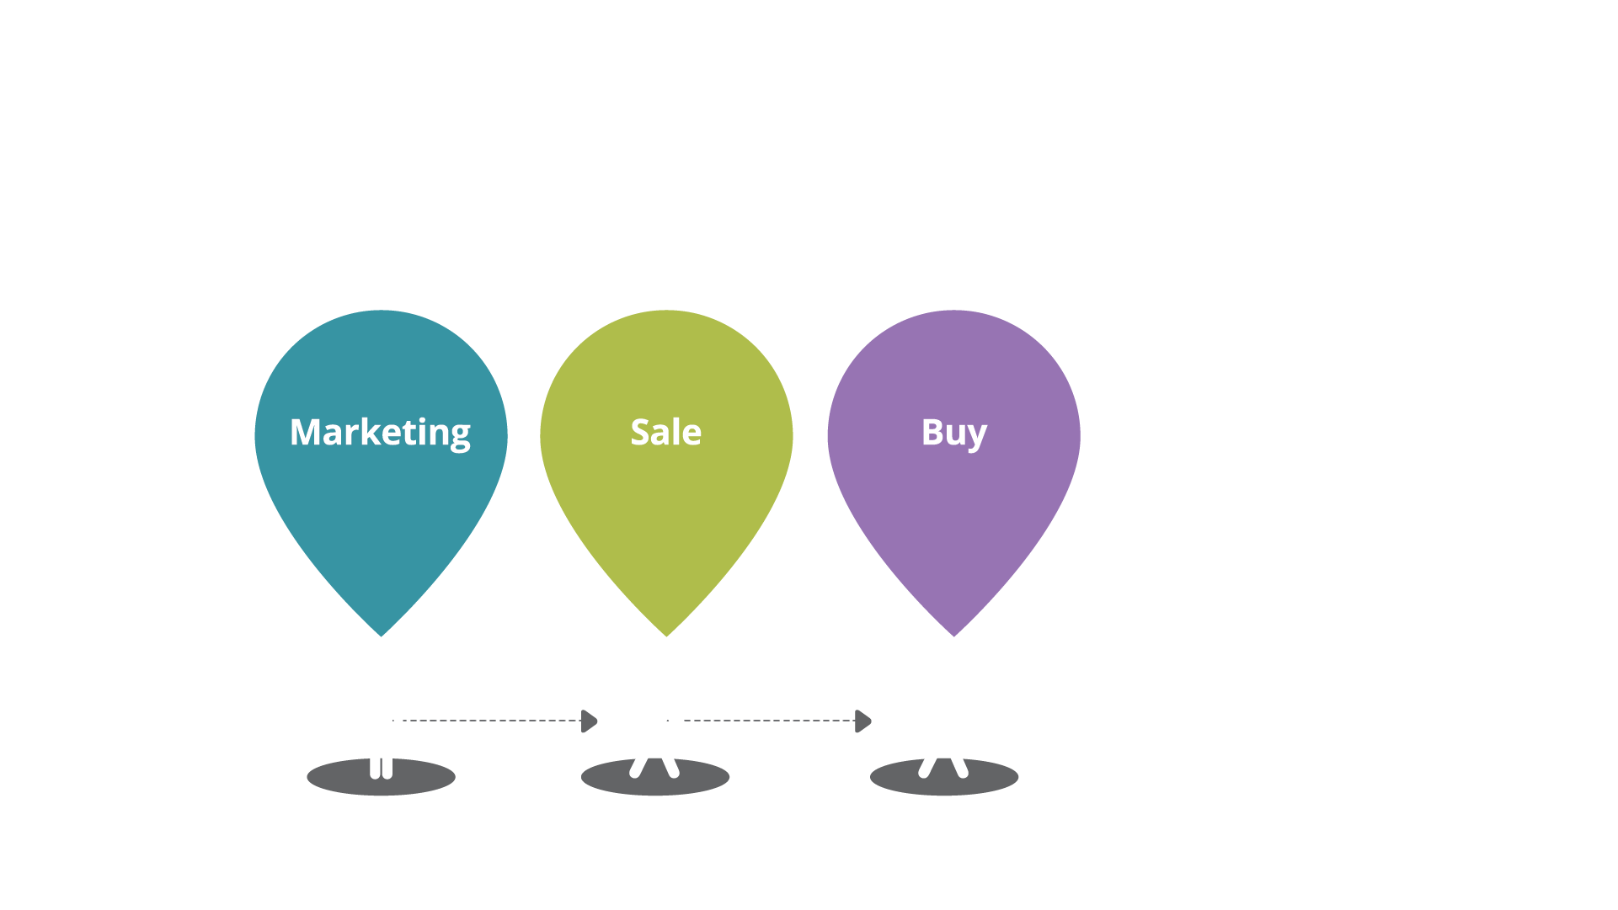
Your Customer’s Journey.

Slide 52
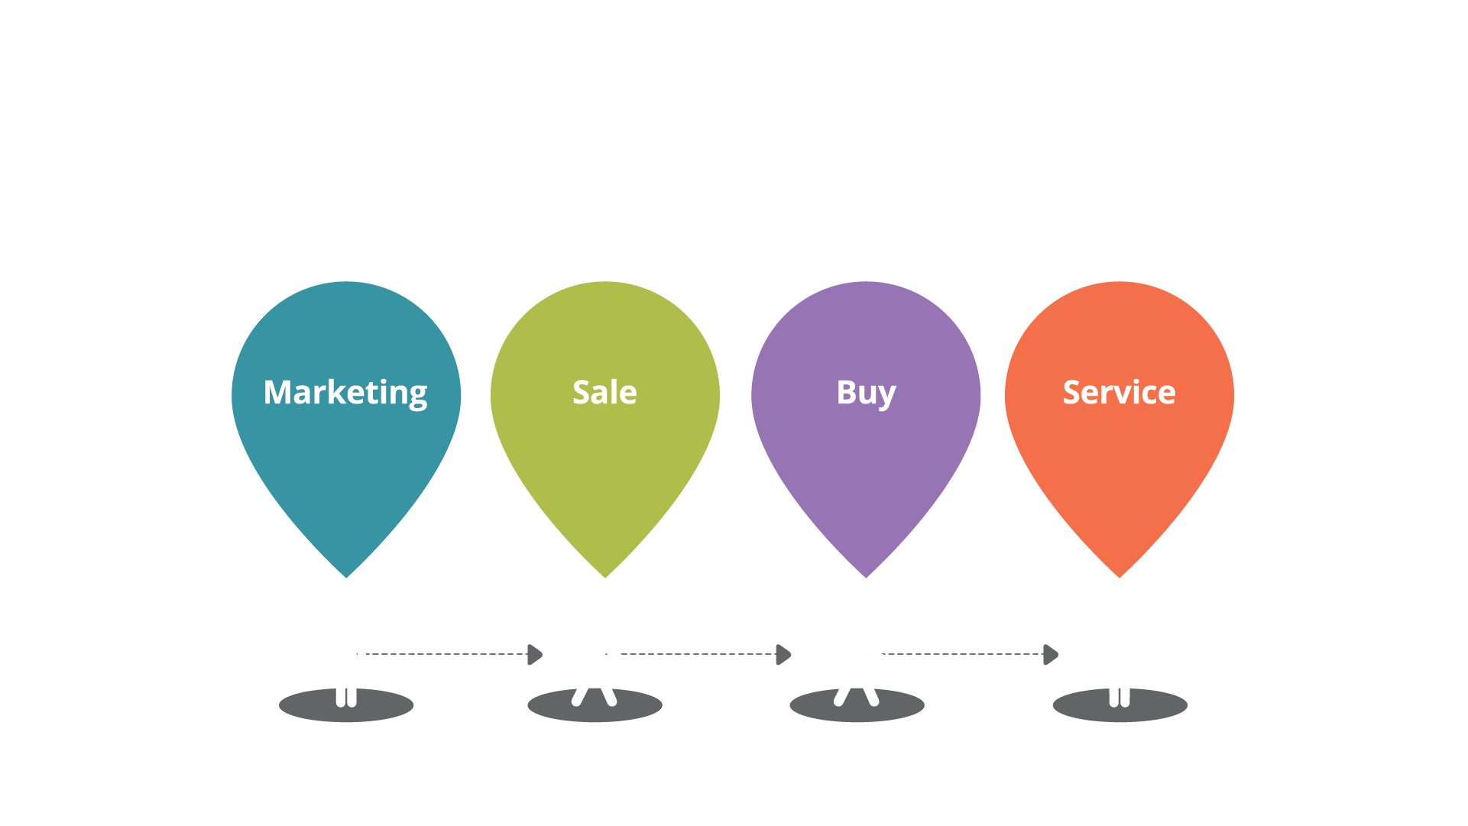
Your Customer’s Journey.

Slide 53
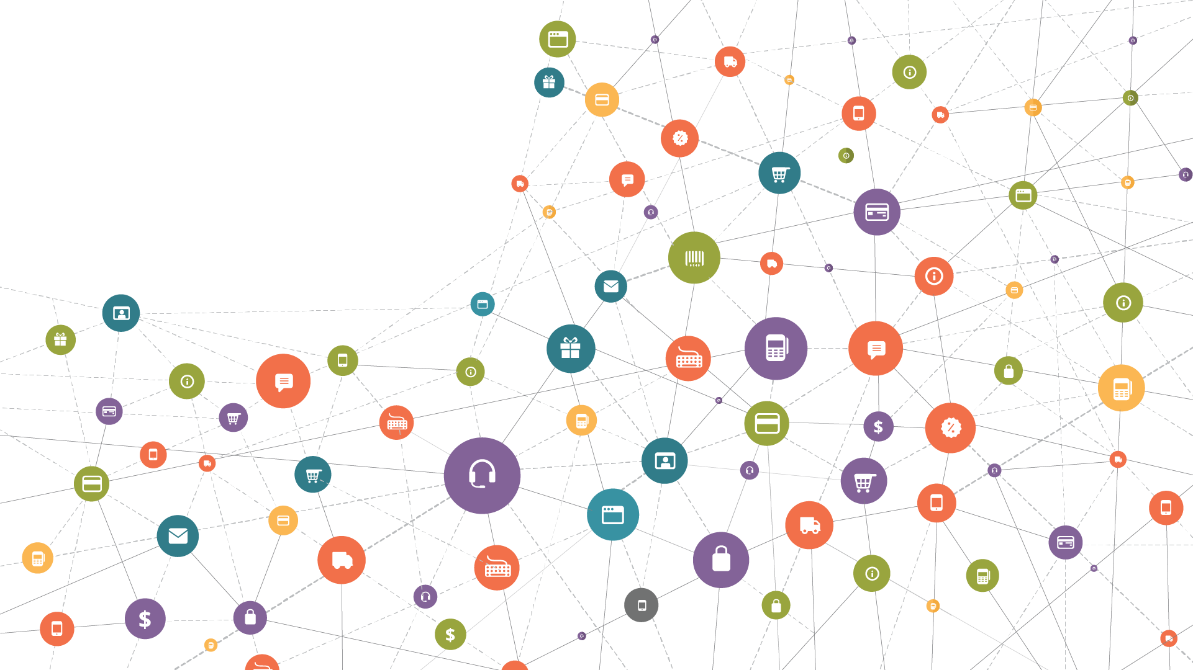
The Customer’s
Actual Journey.

Slide 54
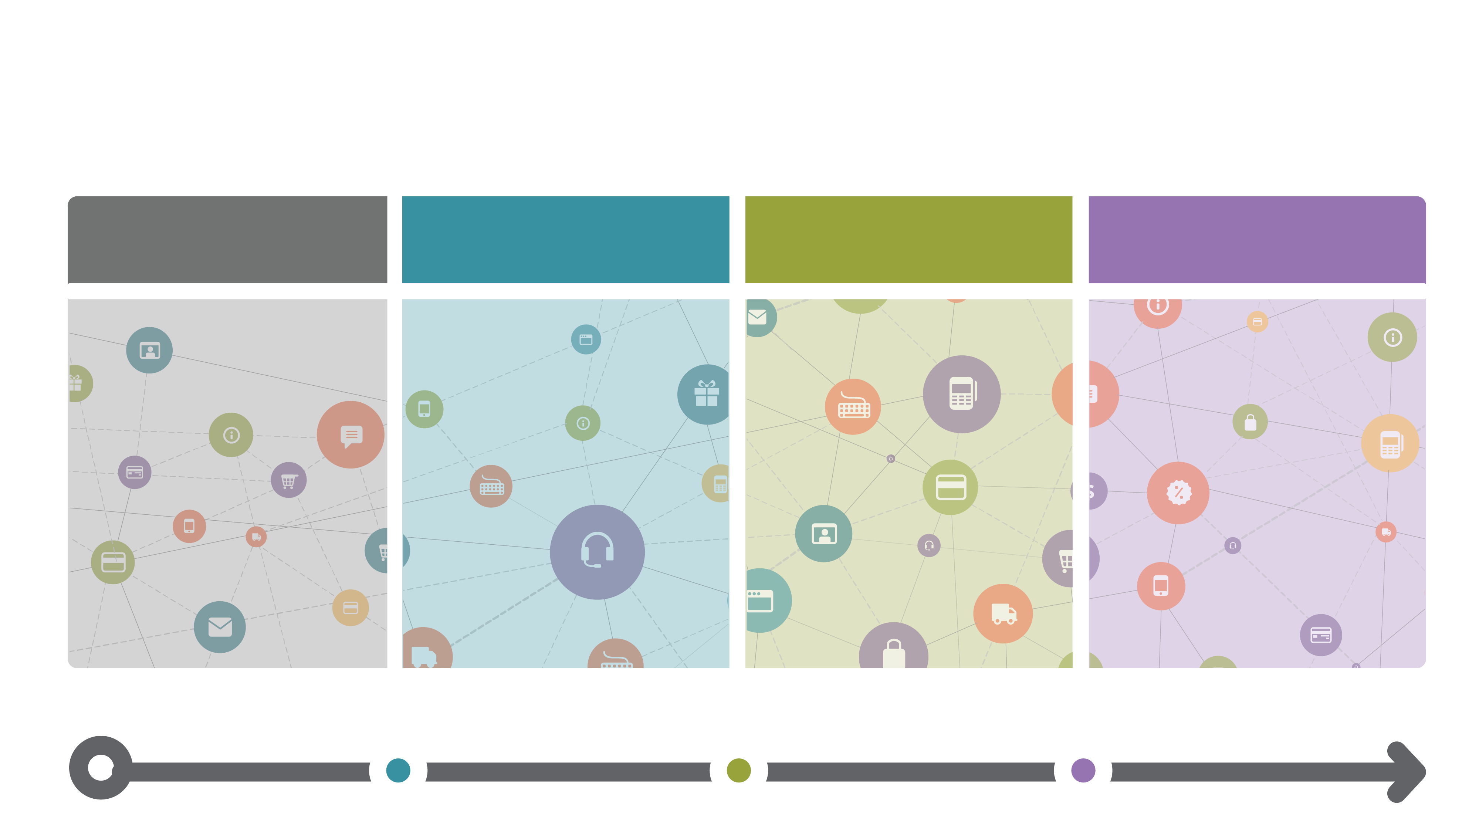
The Journey Framework.
Awareness
Trust
Loyalty
Advocacy

Slide 55
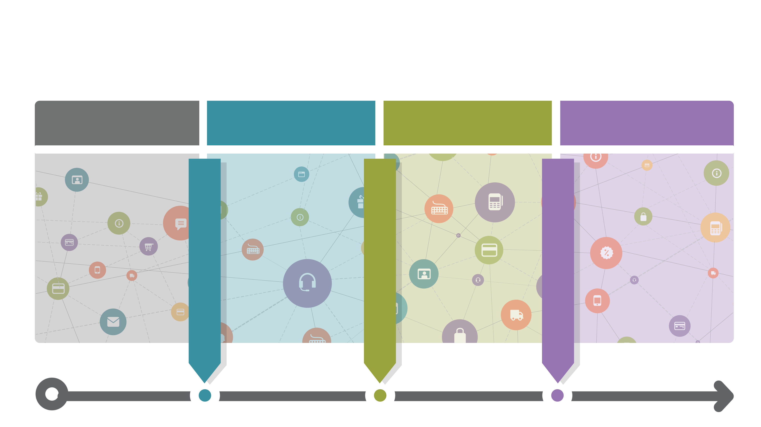
Thresholds.
Awareness
Trust
Loyalty
Advocacy

Slide 56
The Journey Framework.
Awareness
Trust
Loyalty
Advocacy
Investment
Behavior
Regular
Usage
Sharing
Behaviors
Trust Threshold
Loyalty Threshold
Advocacy Threshold
Conversions
Active Users
Feedback

Slide 57
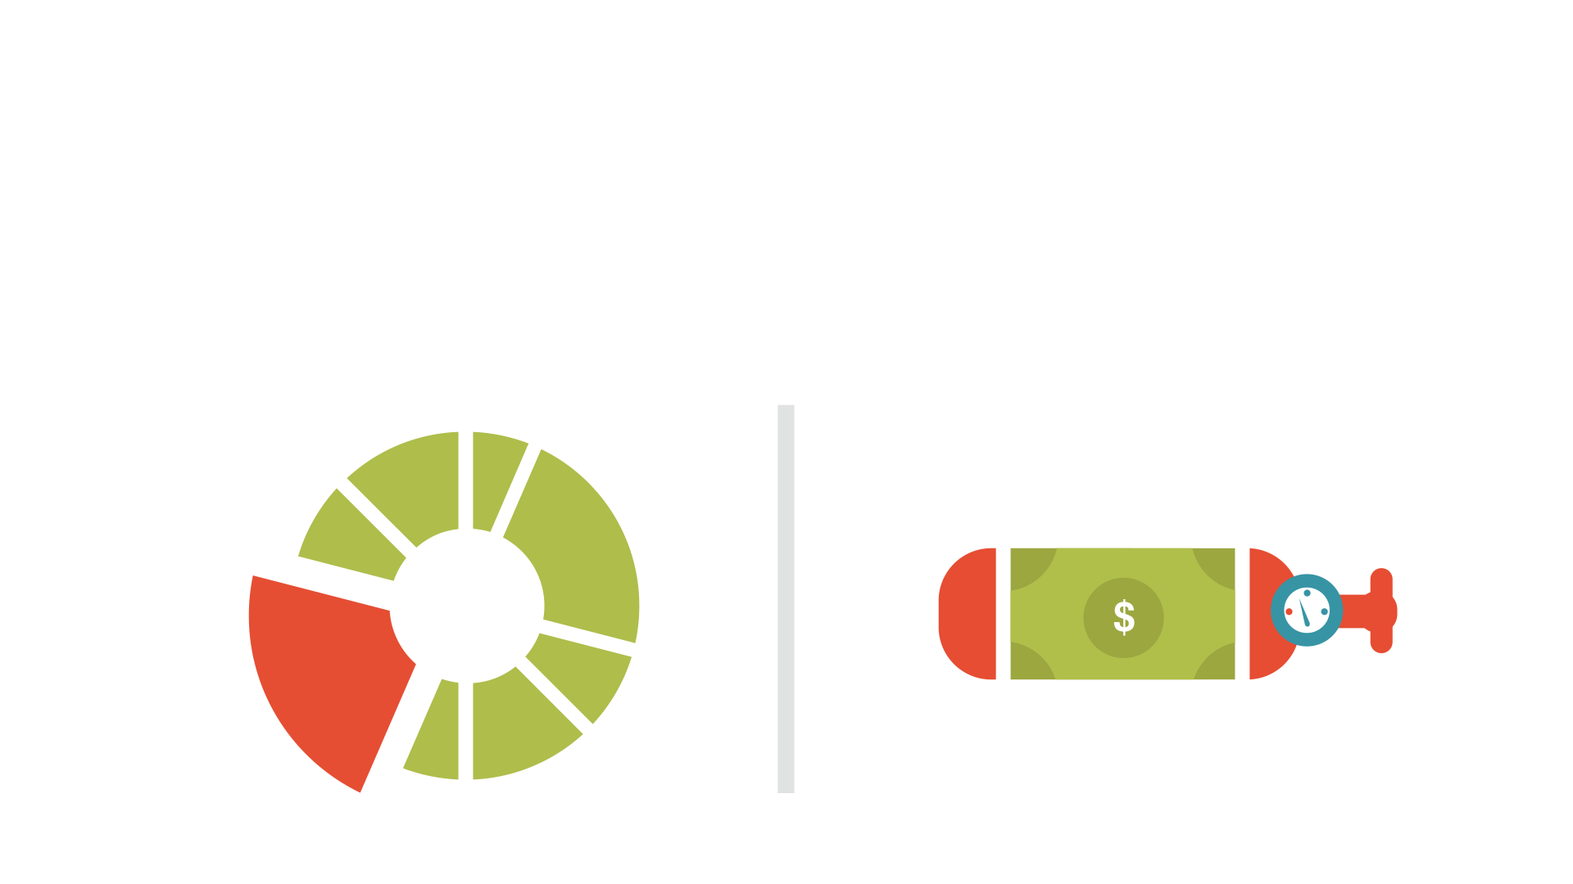
Measuring Software Product Success.
Product Usage vs Product Oxygen
PRODUCT USAGE
PRODUCT OXYGEN

Slide 58
Key Performance Indicators (KPI’s)
BEHAVIOUR
MEASURES
STAKEHOLDER
MEASURES
Trust
Loyalty
Advocacy
ROI
Growth
Conversions

Slide 59
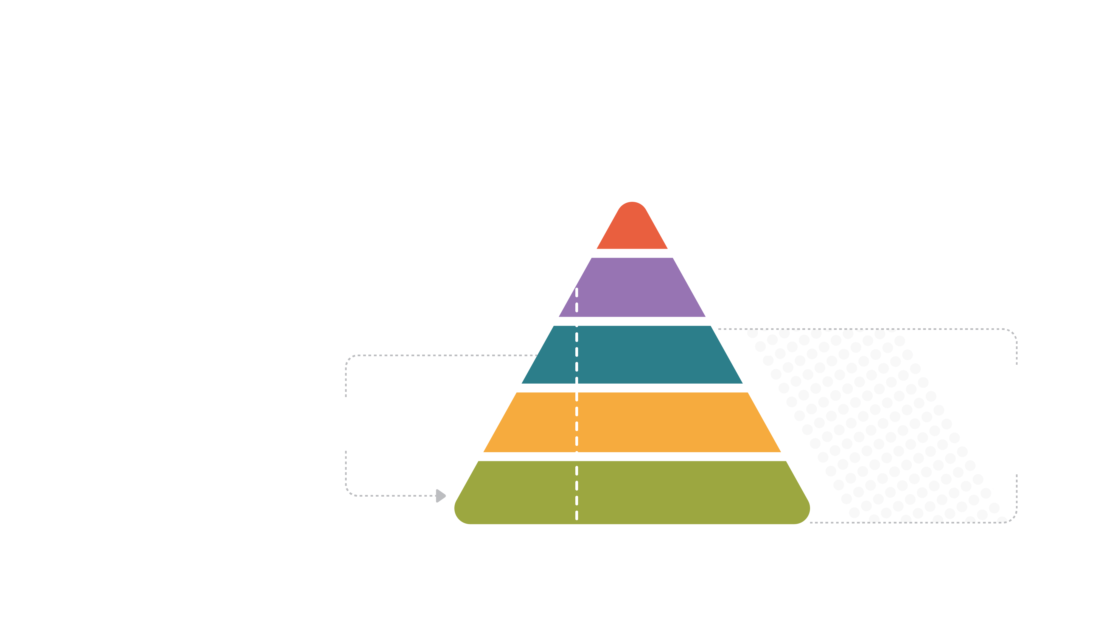
Product Metrics
The Relationship Between Different Metrics
ROI
Business Outcome Metrics
NPS
Customer Sentiment Metrics
Advocacy
Feature-
Level
Metrics
User
Behavior
Metrics
Feeds
Loyalty
Trust
Drive

Slide 60
Listen.
How To Identify Your
Customer’s Needs

Slide 61
“People don’t know
what they want until you show it
to them.”

Slide 62
“People don’t know
what they want until you show it
to them.”
- Steve Jobs.

Slide 63
“It isn’t normal to know
what we want. It’s a rare and difficult psychological achievement.”

Slide 64
“It isn’t normal to know
what we want. It’s a rare and difficult psychological achievement.”
- Abraham Maslow.

Slide 65
“If I had asked my customers
what they wanted, they would’ve said
faster horses.”

Slide 66
“If I had asked my customers
what they wanted, they would’ve said
faster horses.”
– Henry Ford.

Slide 67
“If I had asked my customers
what they wanted, they would’ve said
faster horses.”
– Unknown (but Wise) Consultant.

Slide 68
The Voice
of Customer.
Passive
Active
A model for maximizing our understanding of needs and wants
Direct
User
Feedback
Surveys
Focus Groups
Indirect
Activity
Analysis
Workshops

Slide 69
Surveys Focus
Groups.
Passive
Active
Active/Direct
Direct
- Customer Surveys (NPS)
- Customer Focus Groups
- Customer Communities
- User Studies & Testing
User
Feedback
Surveys
Focus Groups
Indirect
Activity
Analysis
Workshops

Slide 70
User Feedback.
Passive
Active
Passive/Direct
- Feedback
- Customer Service Calls
Direct
User
Feedback
Surveys
Focus Groups
Indirect
Activity
Analysis
Workshops

Slide 71
Activity Analysis.
Passive
Active
Passive/Indirect
- Competitive Analysis
- Analytics
- Service Logs
Direct
User
Feedback
Surveys
Focus Groups
Indirect
Activity
Analysis
Workshops

Slide 72
Workshops.
Passive
Active
Active/Indirect
- Team Surveys
- Workshops
Direct
User
Feedback
Surveys
Focus Groups
Indirect
Activity
Analysis
Workshops

Slide 73
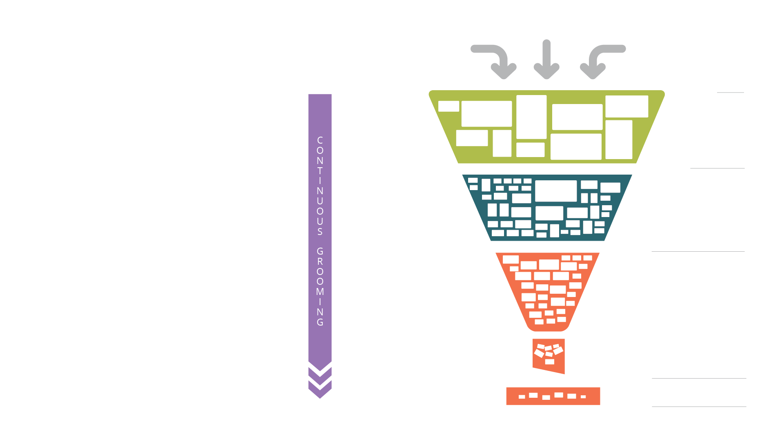
The Backlog.
The Future
of a Software
Product.
Ideas
Prioritize
IDEAS
(Themes)
T-shirt Size
Prioritize
BACKLOG
(Epics)
Size
Prioritize
Define
EXECUTABLE
BACKLOG
(Stories)
Sprint Plan
NEXT SPRINT
Execute
CURRENT SPRINT

Slide 74
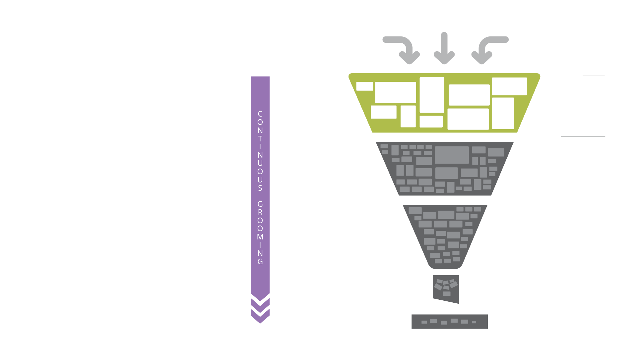
The Backlog.
The Idea Funnel.
Ideas
Prioritize
IDEAS
(Themes)
T-shirt Size
Prioritize
BACKLOG
(Epics)
Size
Prioritize
Define
EXECUTABLE
BACKLOG
(Stories)
Sprint Plan
NEXT SPRINT
Execute
CURRENT SPRINT

Slide 75
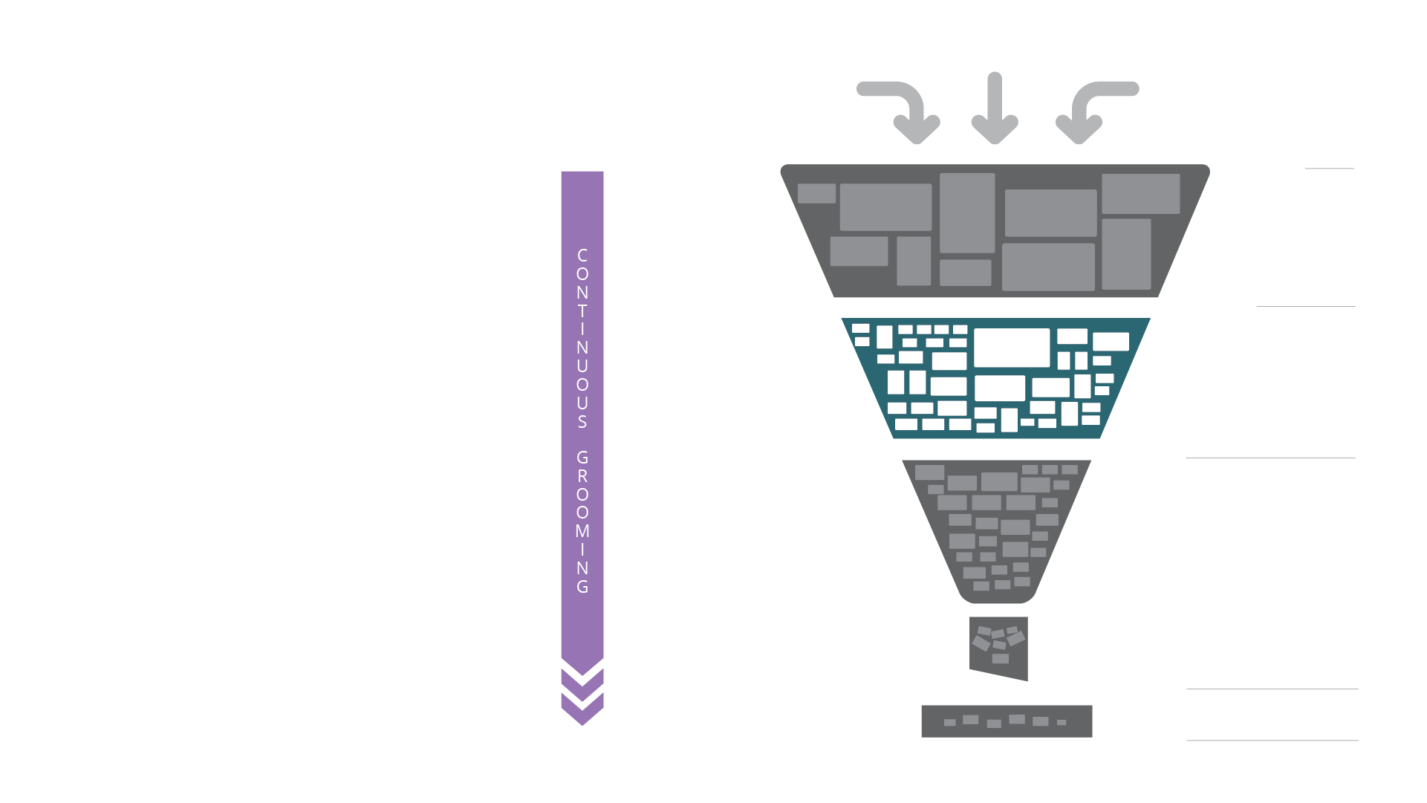
The Backlog.
The Roadmap
MLTB:
Minimum Long Term Backlog
Ideas
Prioritize
IDEAS
(Themes)
T-shirt Size
Prioritize
BACKLOG
(Epics)
Size
Prioritize
Define
EXECUTABLE
BACKLOG
(Stories)
Sprint Plan
NEXT SPRINT
Execute
CURRENT SPRINT

Slide 76
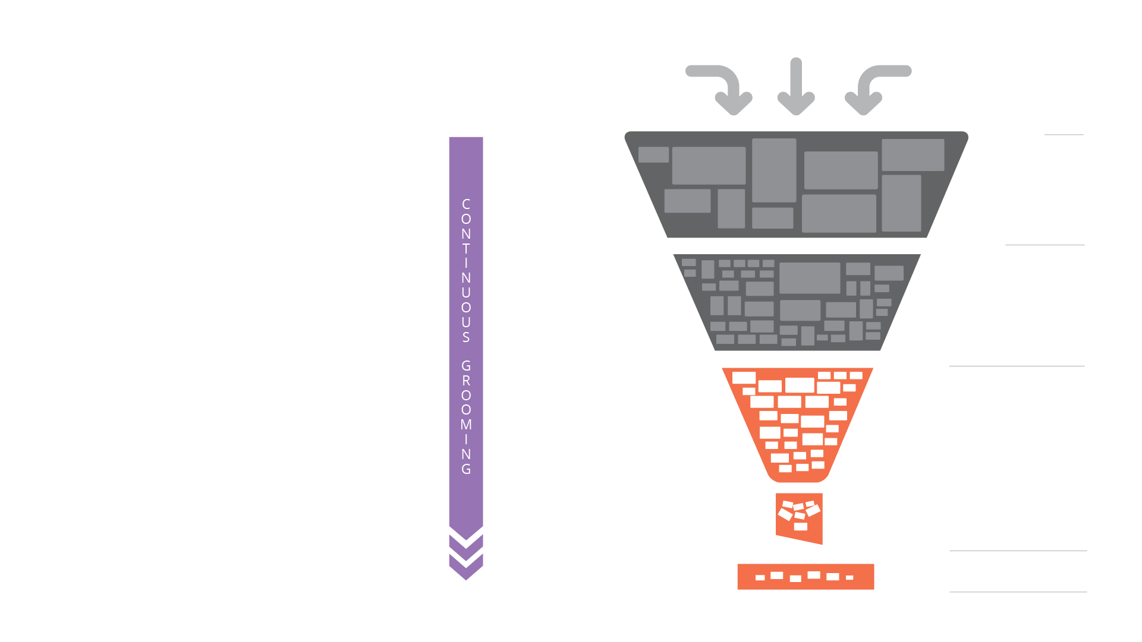
The Backlog.
MVB:
Minimum Viable Backlog
OB:
Optimum Backlog
Ideas
Prioritize
IDEAS
(Themes)
T-shirt Size
Prioritize
BACKLOG
(Epics)
Size
Prioritize
Define
EXECUTABLE
BACKLOG
(Stories)
Sprint Plan
NEXT SPRINT
Execute
CURRENT SPRINT

Slide 77
Iceberg Principle.
USABLE
FUNCTIONAL
RISK MANAGED
EFFICIENTLY
BUILT
FUTURE READY
PERFORMANT
SUPPORTABLE

Slide 78
Risk Managed.
- Secure
- Compliant
- Licensed
- Auditable

Slide 79
Efficiently Built.
- Standardized Toolsets
- Best Coding Practices
- Source Controlled

Slide 80
Future Ready.
- Reusable
- Modular
- Debt Managed
- Documented

Slide 81
Performant
- Responsive
- Scalable
- Reliable

Slide 82
Supportable.
- Serviceable
- Testable
- Traceable
- Maintainable
- Deployable

Slide 83
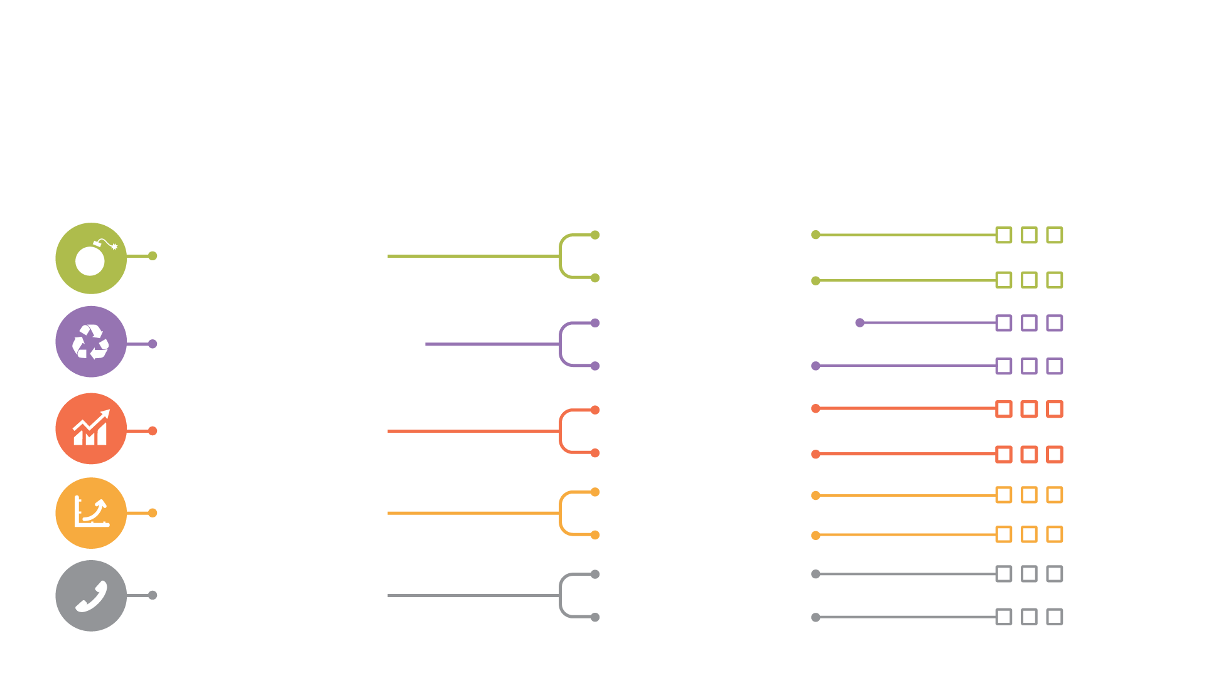
The Balancing Act.
Your Team Has To Choose
Compliant
RISK MANAGED
Secure
EFFICIENTLY
BUILT
Source Managed
Reusable
Modular
FUTURE READY
Extensible
Scalable
PERFORMANT
Reliable
Serviceable
SUPPORTABLE
Testable

Slide 84
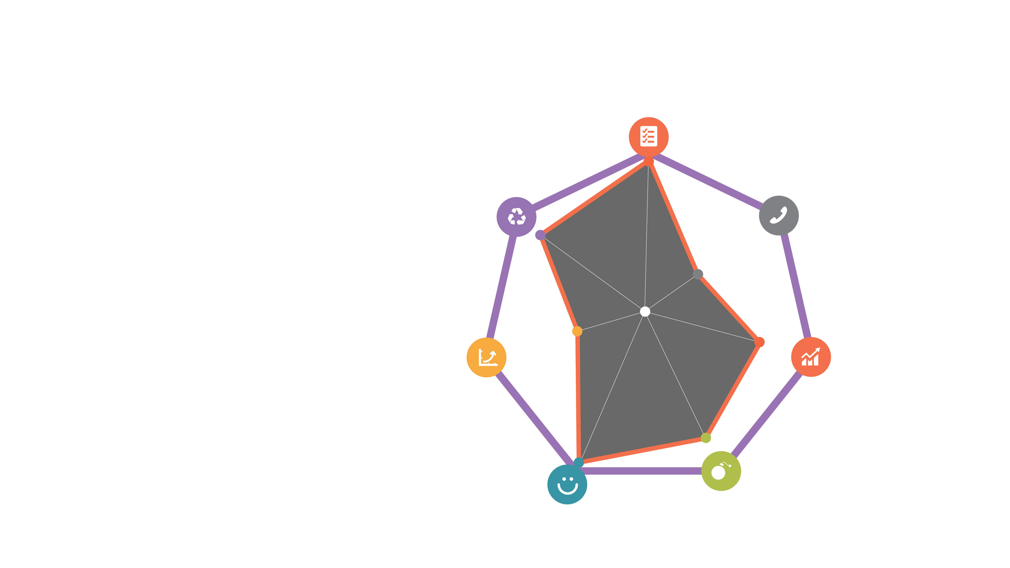
Dimensions
of Quality.
FUNCTIONAL
EFFICIENTLY
BUILT
Every Product has
a Risk Profile
SUPPORTABLE
PERFORMANT
FUTURE READY
USABLE
RISK
MANAGED

Slide 85
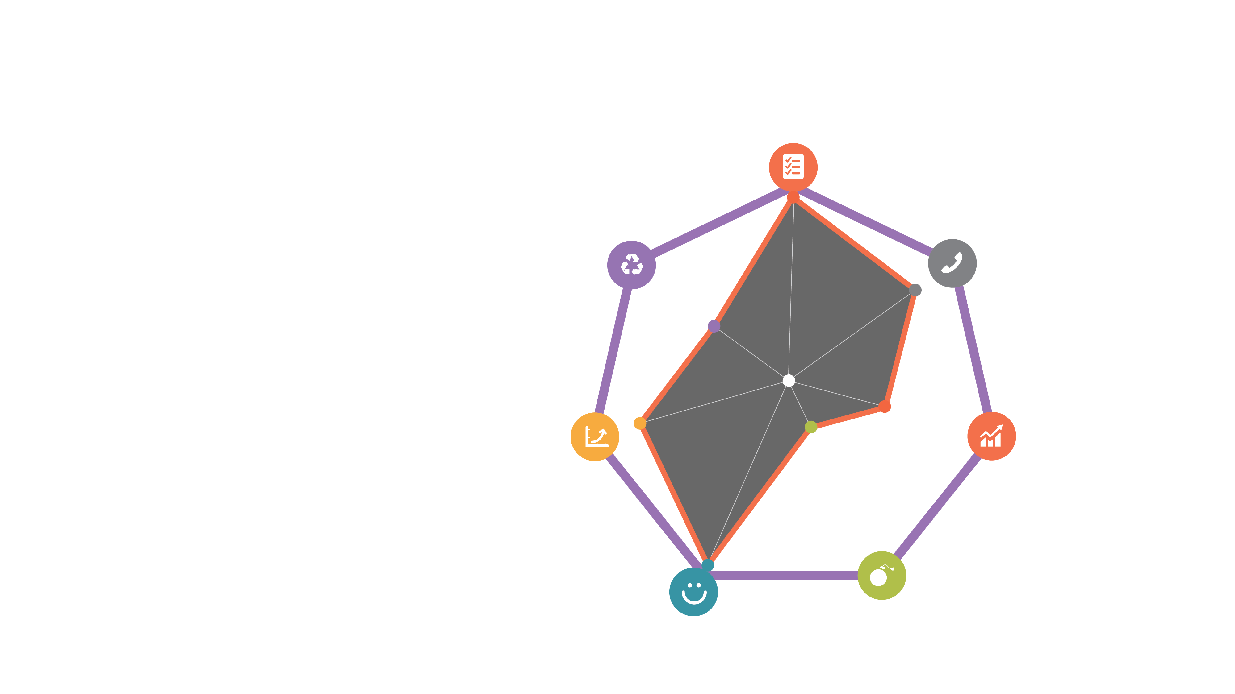
Dimensions
of Quality.
FUNCTIONAL
EFFICIENTLY
BUILT
Every Product’s Risk
Profile is Different
SUPPORTABLE
PERFORMANT
FUTURE READY
USABLE
RISK
MANAGED

Slide 86
Pull:
Creating Software
People Can’t Live
Without

Slide 87
Questions.
INSPIRE
TOUCH
MOVE

Slide 88
References.
Standing Upon The Shoulders of Giants.
Golden Circle: Attributed to Simon Sinek; Start With Why(2011)
https://www.startwithwhy.com/
Johari Window (Knowns to Unknown Unknowns): Attributed to Joseph Luft and Harrington Ingham (Jo + Hari): https://en.wikipedia.org/wiki/Johari_window
Self Determination Theory: Adapted from Edward Deci and Richard Ryan’s work:
http://selfdeterminationtheory.org/

